Slide 1
Data Stuctures and Algorithms
Dr. Fidaa Abed

Slide 2
Sorting Algorithms
Selection Sort
Bubble Sort

Slide 3
Sorting problem
Input: Array of n elements
Output: Array array sorted in nondecreasing order

Slide 4
Selection Sort

Slide 5
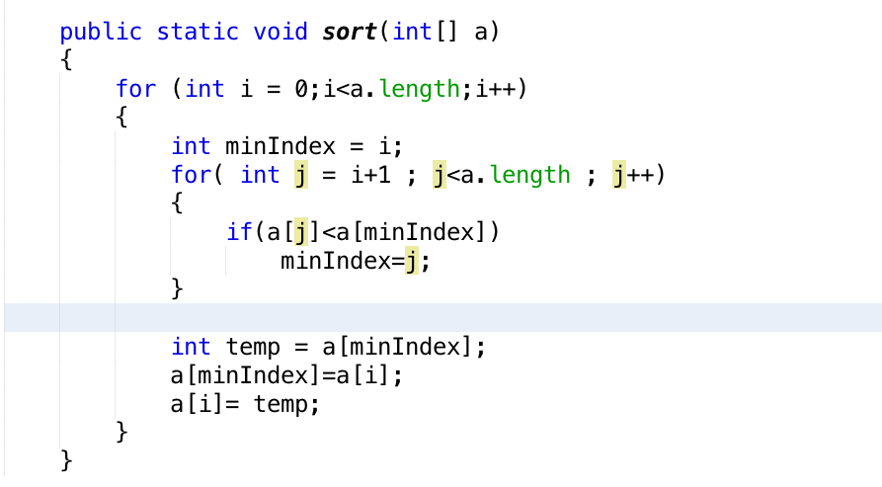
Selection Sort

Slide 6
Selection Sort Analysis
n+ (n-1) + (n-2) ….. +1 = n(n+1)/2
Best Case: O(n²)
Worst Case: O(n²)
Average Case: O(n²)

Slide 7
Excercise
Write a method that orders an integer array in non-increasing order using selection sort.
Write a method that orders an an array of strings in alphabatical order using selection sort.

